Slide 1
Random Effects in Social Media Usage
Alexis, Alex, Cameron
Notes:
Cameron

Slide 2
Objective
Creating a model that predicts daily social media usage with the ultimate goal of determining what factors influence overall usage time.
Notes:
Cameron

Slide 3
Data Overview
A multimodal dataset designed to analyze patterns in social media behavior. Includes 10 variables capturing demographic factors, platform activity, engagement metrics, and emotional context to better understand predictors of daily social media usage.
A Few Variables:
Posts_Per_Day: Number of posts made per day.
Comments_Received_Per_Day: Number of comments received per day.
Dominant_Emotion: The dominant emotional state of the user during the day (e.g., Happiness, Sadness, Anger, Anxiety, Boredom, Neutral).
Daily_Usage_Minutes: Total minutes spent daily on the specified platform.
Platform: The social media platform used by the user (e.g., Instagram, Twitter, Facebook, LinkedIn, Snapchat, Whatsapp, Telegram).
https://www.kaggle.com/datasets/emirhanai/social-media-usage-and-emotional-well-being?select=train.csv
Notes:
Cameron

Slide 4
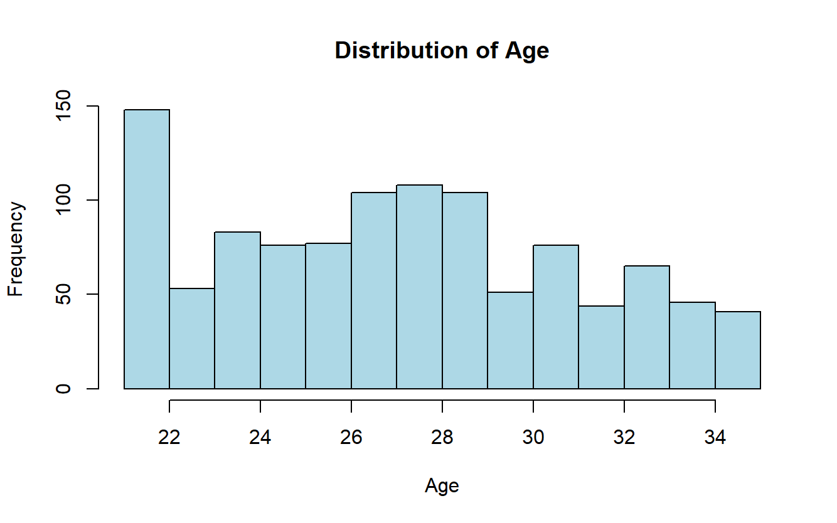
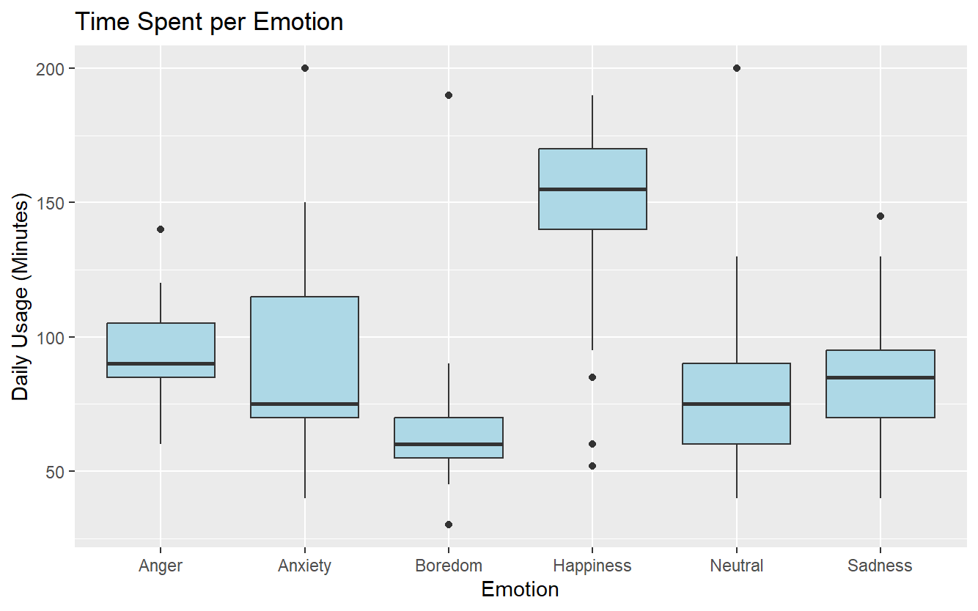
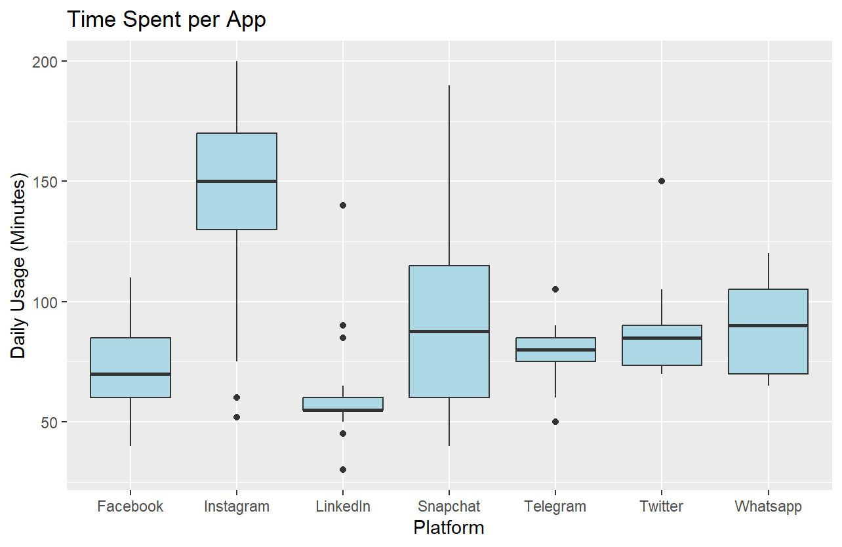
Data Exploration
Notes:
alexis

Slide 5
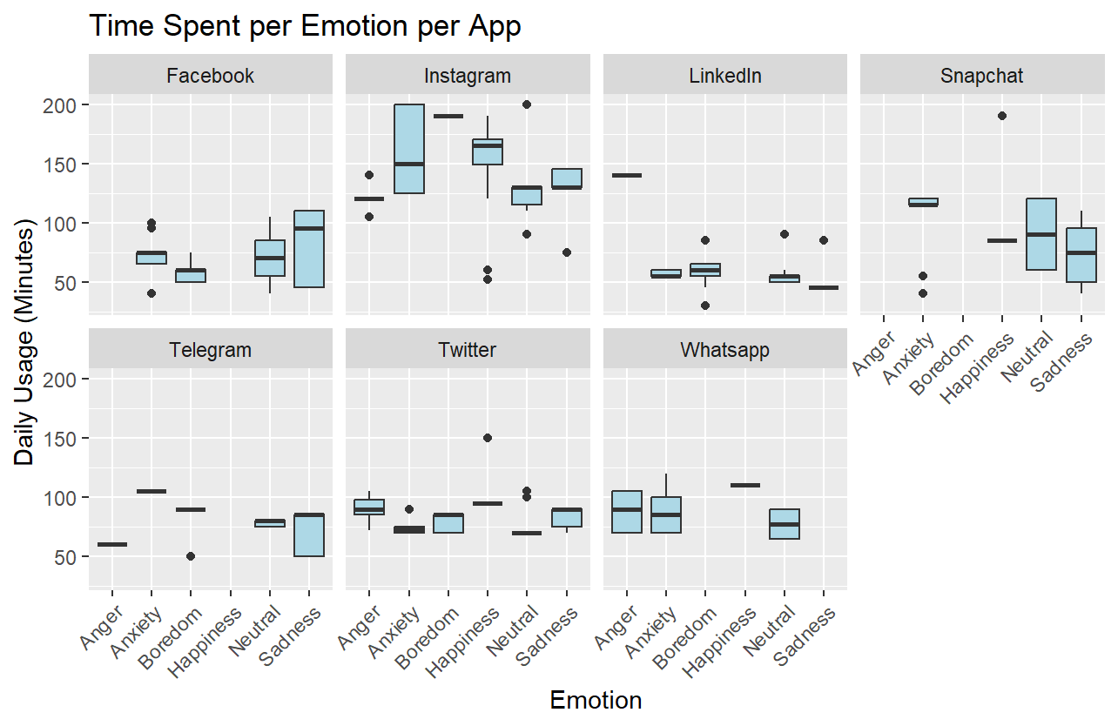
Notes:
alexis

Slide 6
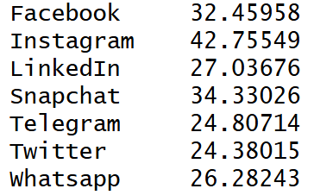
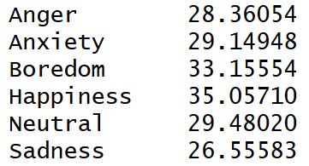
Final Model
Platform
Random Effect Estimates
Y = ꞵ₀ + ꞵ₁x₁ + ꞵ₂x₂ + ꞵ₃x₃ + ꞵ₄x₄ + ꞵ₅x₅ + ɑ₁x₁ + ɑ₂x₂ + ε
Fixed Effect | Estimate
Gender1 | 1.823774
Gender2 | -1.190442
Posts_per_day | 2.578717
Likes_recieved_per_day | 0.3820382
Messages_sent_per_day | 1.308504
Comments_recieved_per_day | 0.6693137
Dominant Emotion
Random Effect Estimates
Notes:
alexis

Slide 7

Final Model
Y = ꞵ₀ + ꞵ₁x₁ + ꞵ₂x₂ + ꞵ₃x₃ + ꞵ₄x₄ + ꞵ₅x₅ + ꞵ₆x₆ +ɑ₁x₁ + ɑ₂x₂ + ε
ɑ_{1,2} = N(0, 𝝈²_{a})
ε = N(0, 𝝈²)
Where ɑ₁ and ɑ₂ are random effect terms and assumed to be normally distributed.
Variance Estimates:
𝝈²_{Platform} = 46.36
𝝈²_{Dominant_emotion} = 11.12
𝝈²_{Residual} = 135.67
Notes:
alexis

Slide 8
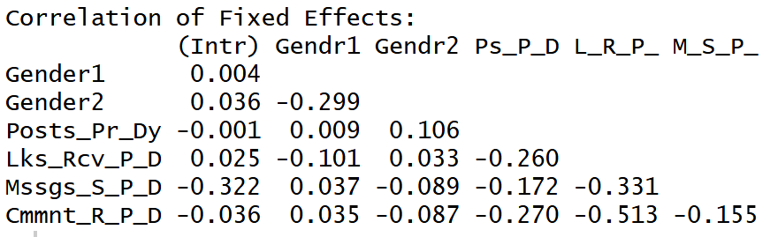
Final Model
Y = ꞵ₀ + ꞵ₁x₁ + ꞵ₂x₂ + ꞵ₃x₃ + ꞵ₄x₄ + ꞵ₅x₅ + ꞵ₆x₆ +ɑ₁x₁ + ɑ₂x₂ + ε
ɑ_{1,2} = N(0, 𝝈²_{a})
ε = N(0, 𝝈²)
Where ɑ₁ and ɑ₂ are random effect terms and assumed to be normally distributed.
Notes:
alexis

Slide 9
Model Fitting
Created a full linear model with all fixed effects
Added the two random effects we considered
Removed one fixed effect and compared the reduced model to the full model using F-tests with the Kenward-Roger (KRmodcomp) method.
  If significant, then the fixed effect is significant to the model and should be included.
  Repeated for each of the 6 fixed effect variables.
  Discovered Age was the only variable insignificant to our model.
Notes:
Alex

Slide 10
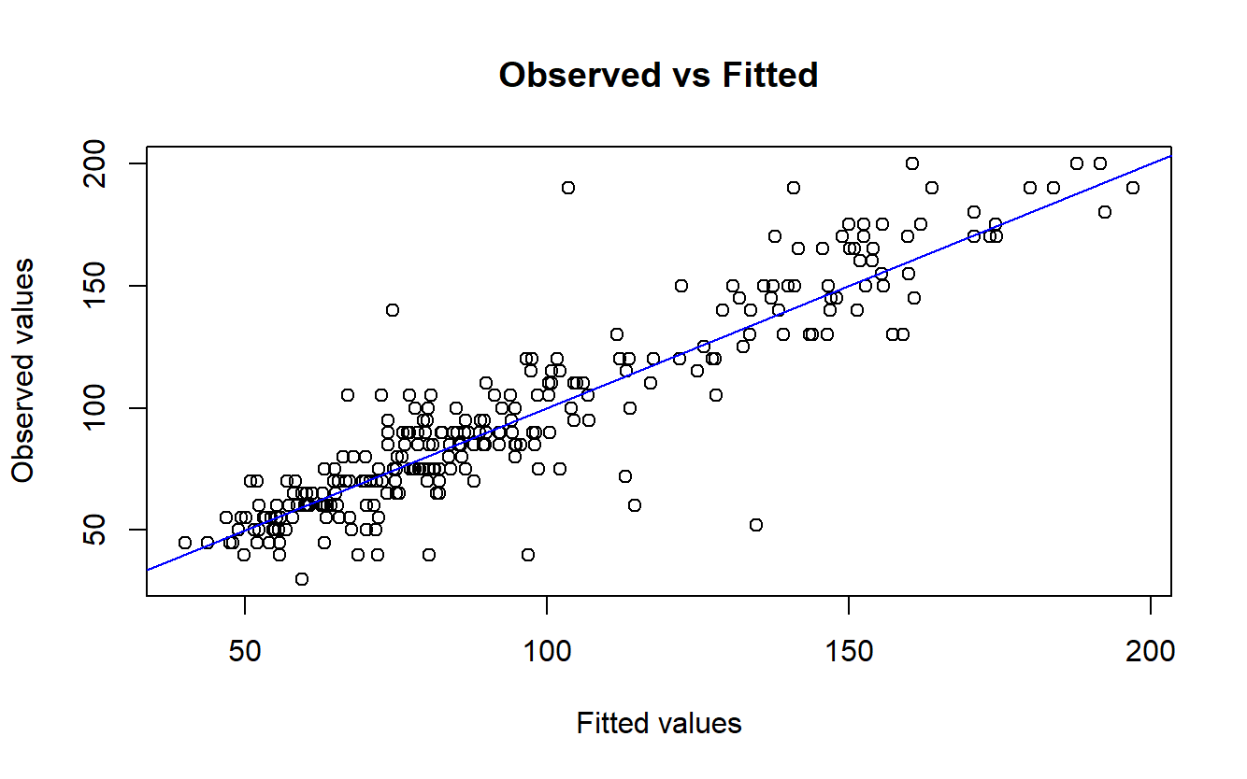
Goodness of Fit
Used exactRLRT() to test for significance of Platform and Emotion random effects
Platform RLRT: 118.23
Emotion RLRT: 37.908
Both have p-values of 0
Two significant random effect terms
Notes:
Alex

Slide 11

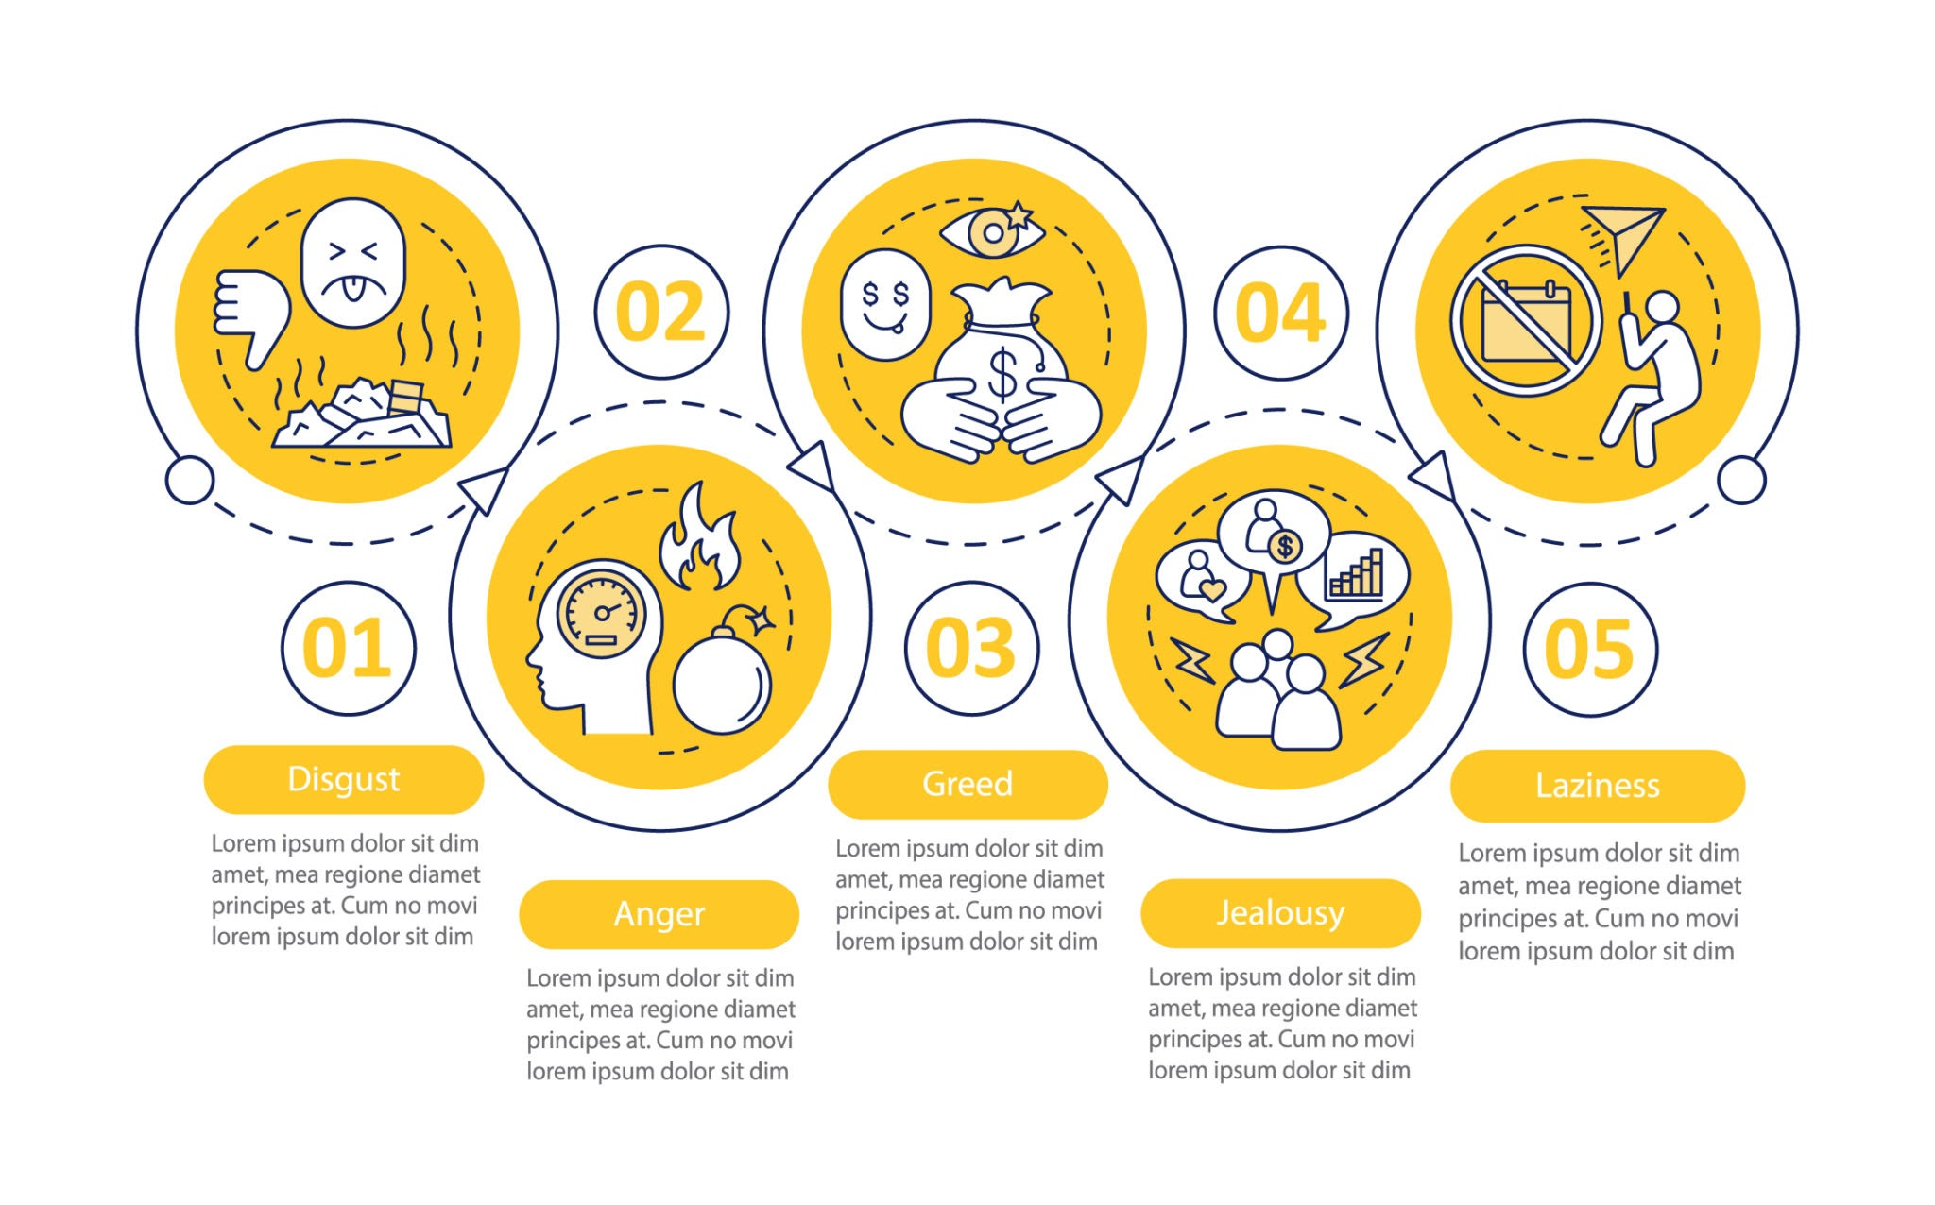
Why Use Random Effects?
Emotion can be hard to quantify
Other options than those given (Jealousy, Excited, Stressed) or (TikTok, Hinge, YikYak)
Can be a combination of the options
Could suffer from response bias
Certain platforms can yield certain responses, should account for that
Notes:
Alex

Slide 12
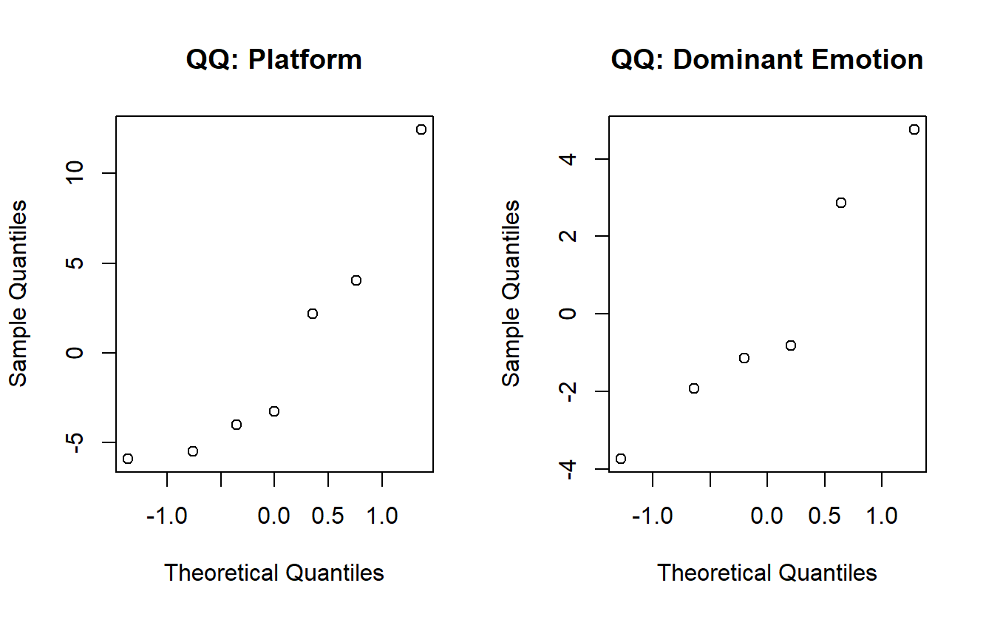
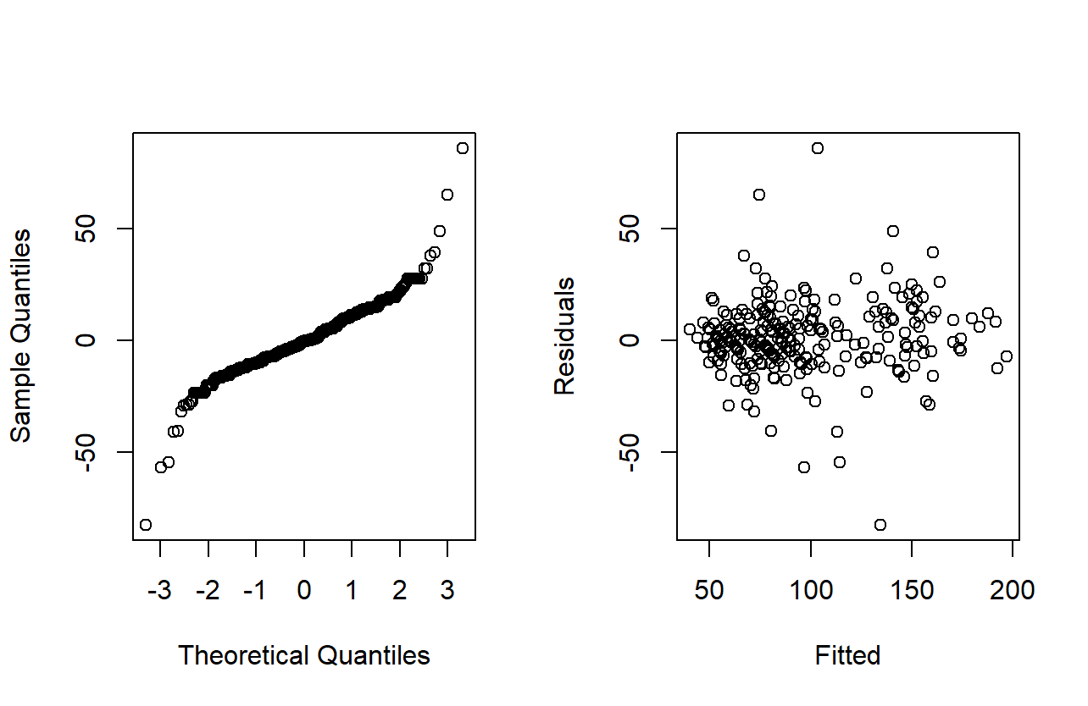
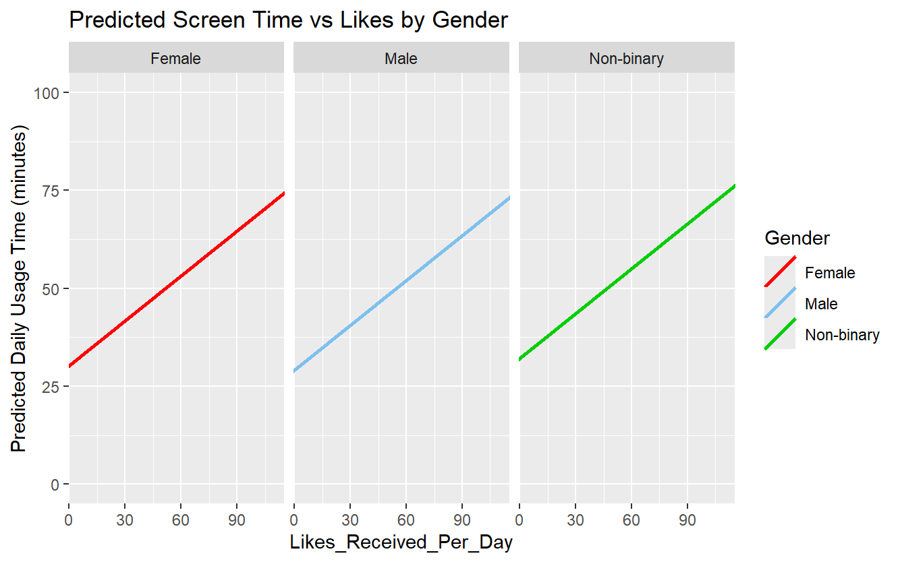
Diagnostics
Notes:
Alex

Slide 13
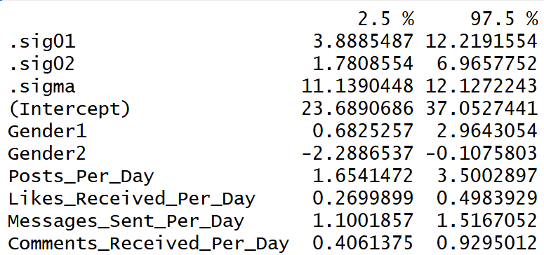
Margin of Error
Fixed-effect MOEs:
Intercept (Female): 6.68
Gender1 (Male): 1.14
Gender2 (Non-Binary): 1.09
Posts Per Day: 0.92
Likes Received Per Day: 0.11
Messages Sent Per Day: 0.21
Comments Received Per Day: 0.26
Random effects MOEs (Standard deviations):
Platform: 4.17
Dominant Emotion: 2.59
Residual: 0.49
Confidence Intervals:
Notes:
Alex

Slide 14
Interpretation
Interpretation of Fixed Effects:
Gender:
Significant— Women tended to use social media longer per day.
Age:
Small negative association with minutes spent per day.
Posts, Likes, Comments, Messages:
All are strong, significant, positive predictors.
Engaging more (posting, liking, messaging) means more daily screen time
Interpretation of Random Effects:
Platform:
Some platforms have much higher baseline usage (e.g., Instagram). Others show lower usage (e.g., LinkedIn).
Dominant Emotion: Emotions influence time spent (Sadness, Anxiety, Happiness shift baseline differently). This reflects behavioral differences in emotional states.
Notes:
Cameron

Slide 15
Predictions
Emotion Comparison:
For a Male on Instagram, while keeping every other variable constant, moving from Sadness to Happiness increases predicted usage from about 102 minutes to 110.
Platform Comparison:
For a Female with Neutral as their dominant emotion, while keeping every other variable constant, switching from Instagram to Snapchat reduced predicted usage from about 108 minutes to 99.
Notes:
Cameron

Slide 16
Conclusion – Were we Successful?
Overall success. We were able to build a mixed-effects model that reliably explains variation in daily social media usage. We Found:
Engagement methods strongly predicted screen time
Platform and Emotion produce significant random variation
Gender differences also matter.
Future applications could include sharing this information with parents, guardians, or perhaps teachers. But likely the people who would like the data the most would be the social media platforms themselves to better train their algorithms.
Notes:
Cameron

Slide 17
Thank You!

